Slide 1
Precipitation Nowcasting Using an AI-Enabled Probabilistic Geometric Method
Jared Brown
Wright State University
04/30/2025

Slide 2
Agenda
Introduction/Background
Methodology
Results and Analysis
Conclusion

Slide 3
Introduction and Background

Slide 4
Purpose
The goal of this study was to model precipitative storms as ellipses and predict ellipse movement over 4 different time horizons
5 minutes
30 minutes
60 minutes
120 minutes

Slide 5
Definition of Nowcasting
Accurate forecasting can be critical in weather contingent operations
Disaster Management
Mission Planning
Nowcasting is a subset of weather forecasting
Defined as 0-2 hours in this study
Typically takes place on small scales in the time and space domains
Notes:
Nowcasting defined by World Meteorological Organization as 0-6 hours into the future

Slide 6
Current Approaches
Most current literature falls into one of four methodologies
Numerical Weather Prediction
Motion Field Estimation
Deep Learning
Ensemble Modeling

Slide 7
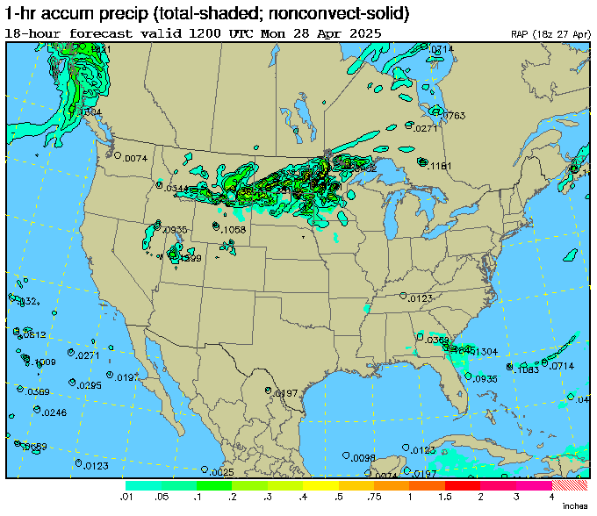
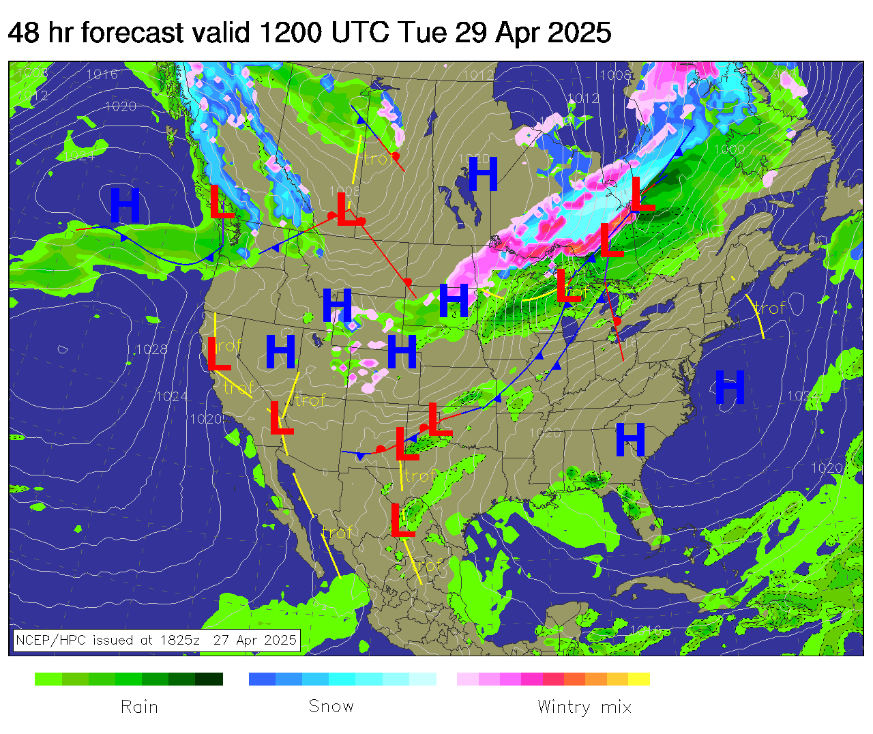
Numerical Weather Prediction (NWP)
Rooted in a physics-based model of atmospheric conditions
Extremely complex and slow
Dominant over long periods of time and space
Struggles on smaller scales
Images courtesy of NSF National Center for Atmospheric Research
Notes:
Based on hydrologic models of the atmosphere
Dominant over long time spans and large spatial scales, but has trouble with the granularity required for nowcasting
Local variations and anomalies have large effect on small scales, but minimal effect on large scales
NSF – National Science Foundation
Images Found at: https://weather.ral.ucar.edu/

Slide 8
Motion Field Estimation (Optical Flow)
Numerical method sometimes bucketed into NWP
Tracks apparent motion in a sequence of images

Slide 9
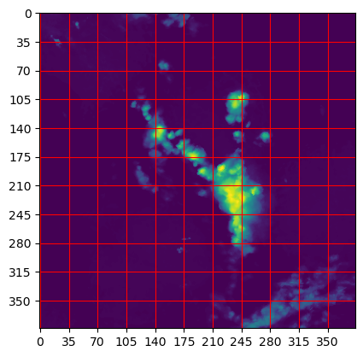
Motion Field Estimation (Optical Flow)
Space is discretized
Notes:
Space is divided into a grid

Slide 10
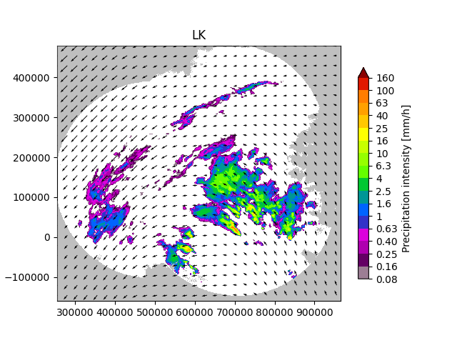
Motion Field Estimation (Optical Flow)
Space is discretized
Velocity Vectors are calculated
Image created using PySTEPs
Notes:
Various methods to calculate velocity
Common ones are Lucas-Kanade and Horn-Schunck
Rely on differencing between adjacent frames in an image sequence
https://pysteps.readthedocs.io/en/latest/auto_examples/plot_optical_flow.html

Slide 11
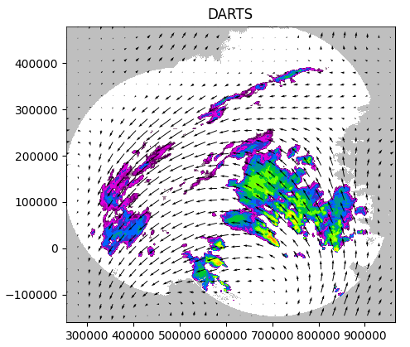
Motion Field Estimation (Optical Flow)
Space is discretized
Velocity Vectors are calculated
Storm is advected along velocities
Image created using PySTEPs
Notes:
Advection: Transport of mass (liquid) through the atmosphere (in this case by wind/pressure gradients)
Commonly uses semi-lagrangian because numerical methods are unstable and discontinuous sometimes
Lagragian: Each particle (pixel/chunk) is followed independently
Eularian: Grid is reinitialized with new values at every time step, but he discretization stays constant
https://pysteps.readthedocs.io/en/latest/auto_examples/plot_optical_flow.html

Slide 12
Motion Field Estimation (Optical Flow)
Space is discretized
Velocity Vectors are calculated
Storm is advected along velocities
Has difficulty accounting for storm growth and decay
Artificial diffusion blurs detail
Notes:
Major cause of growth/decay is convection (vertical movement of liquid)
Convection: Rising of air/heat which usually produces severe thunderstorms (convective storms). Leads to storm growth
Maintains current storm structure
Artificial diffusion can’t capture stark gradients, causes unwanted smoothing (blurriness in images)

Slide 13
Deep Learning
Numerous variations of neural networks
Generative adversarial networks (GANs)
Various combinations of CNNs RNNs and LSTMs
Take sequence of inputs and produce output
Inputs and Output are not necessarily an image
Difficult to establish trust in neural networks
Notes:
Uncertainty can also be expressed in various ways (often blurriness if output is images)

Slide 14
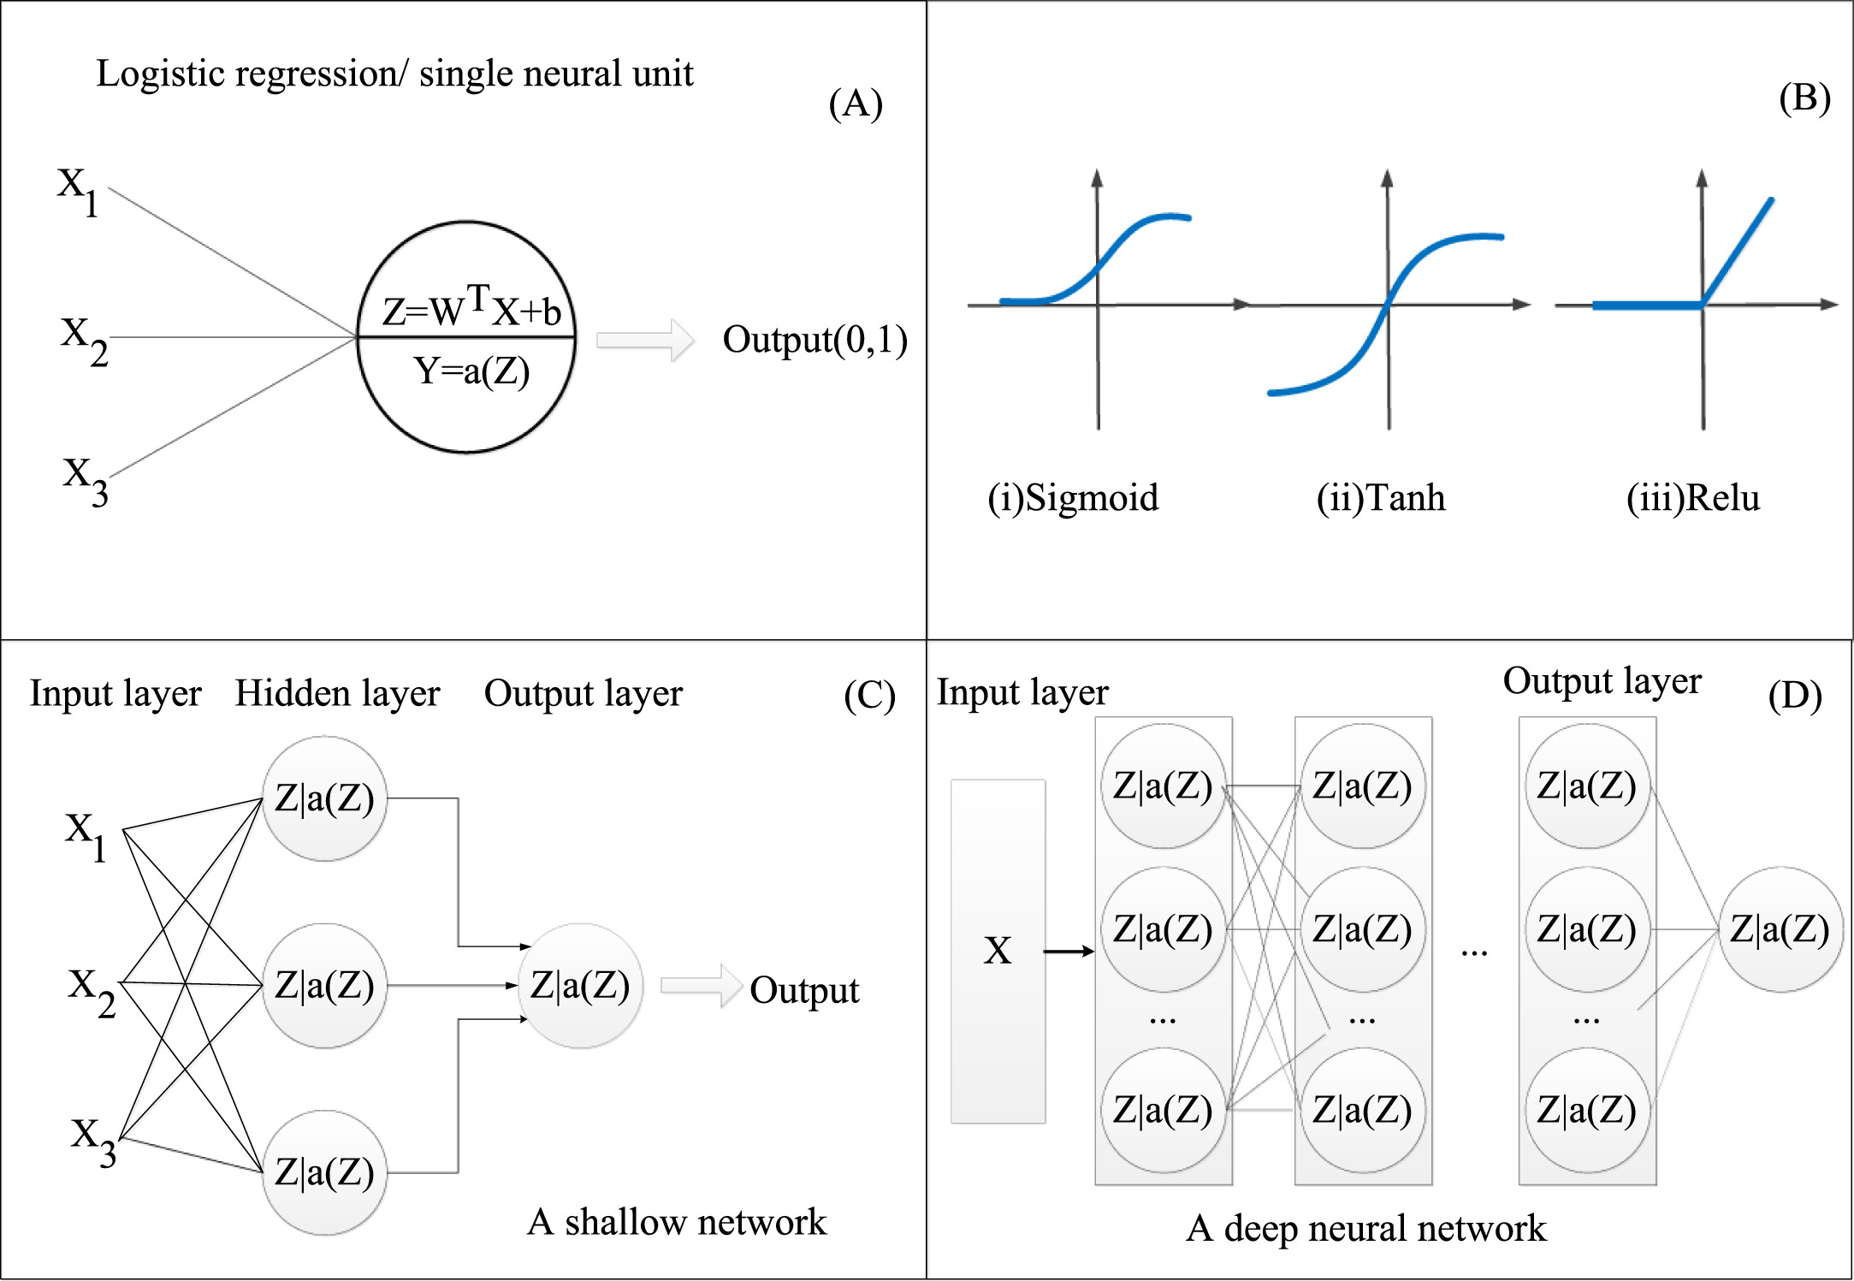
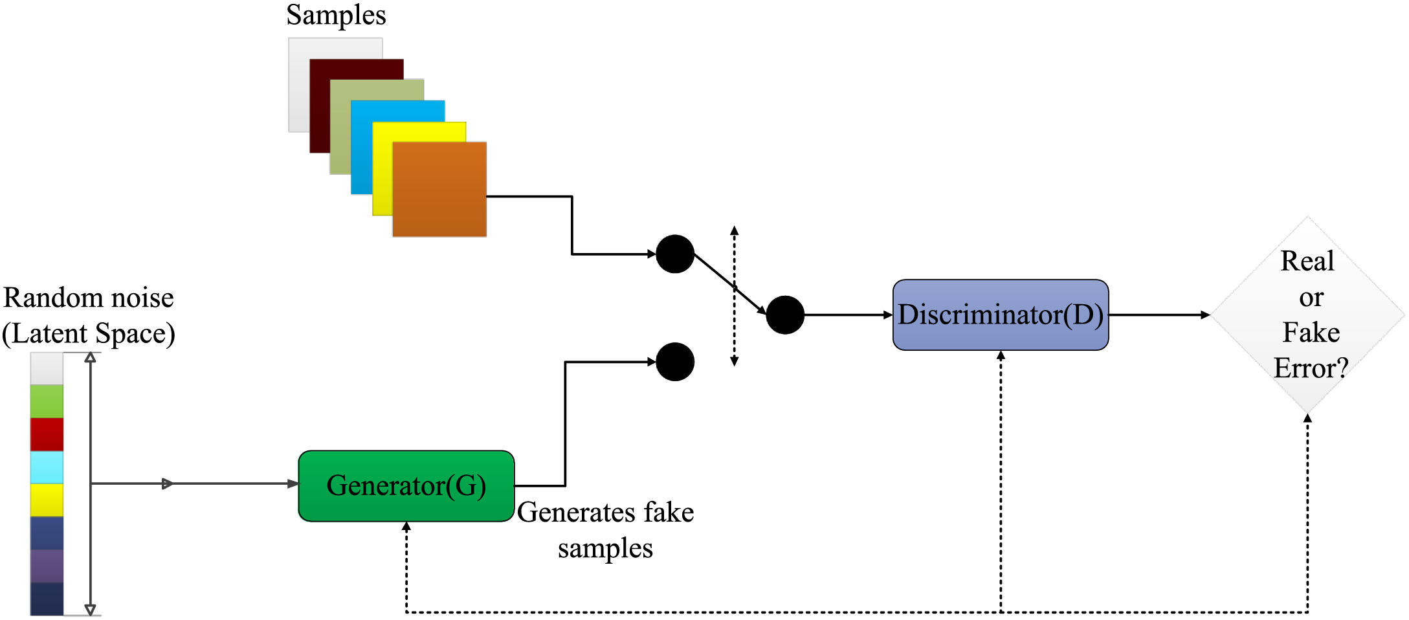
Deep Learning
Images courtesy of
S. Dong, P. Wang and A. Khushnood, "A survey on deep learning and its applications," Computer Science Review, vol. 40, 2021.
Notes:
Can I use images from published paper and cite them?

Slide 15
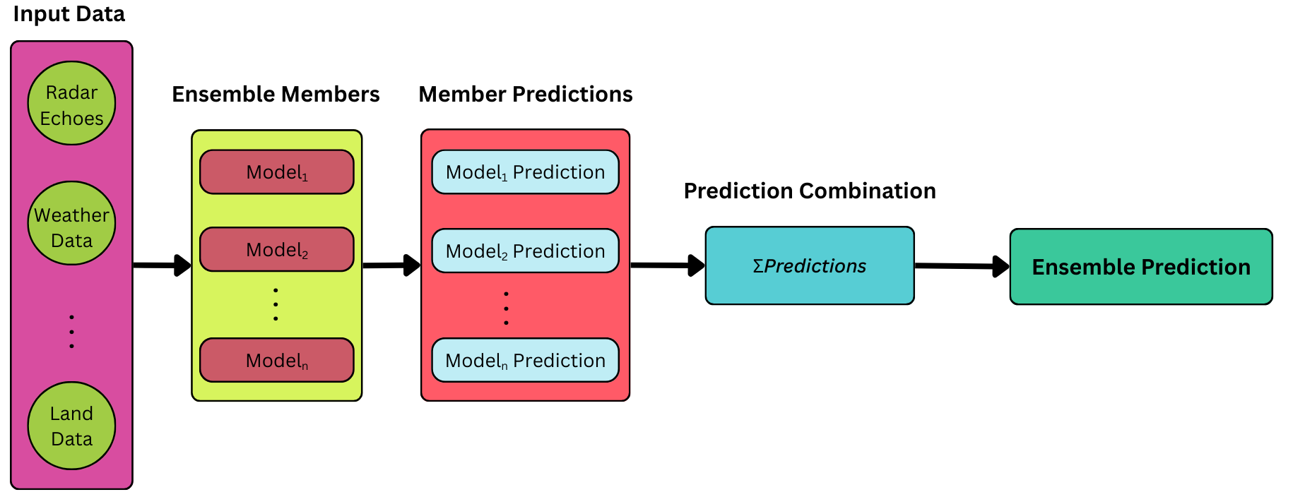
Ensemble Models
Merge outputs from multiple models into a single output
Often combines optical flow with deep learning
Notes:
One interesting approach is using optical flow at multiple frequency bands
Calculate and propagate at different discretizations and then combine results

Slide 16
Nowcasting Challenges and Considerations
No currently defined standard evaluation metrics
Some common metrics are F1 score, Critical Success Index (CSI), Briar Skill Score, and ROC Curve
Difficult to define accuracy or “skillfullness” of a model like this
Dependent on use case and sometimes expert’s preference

Slide 17
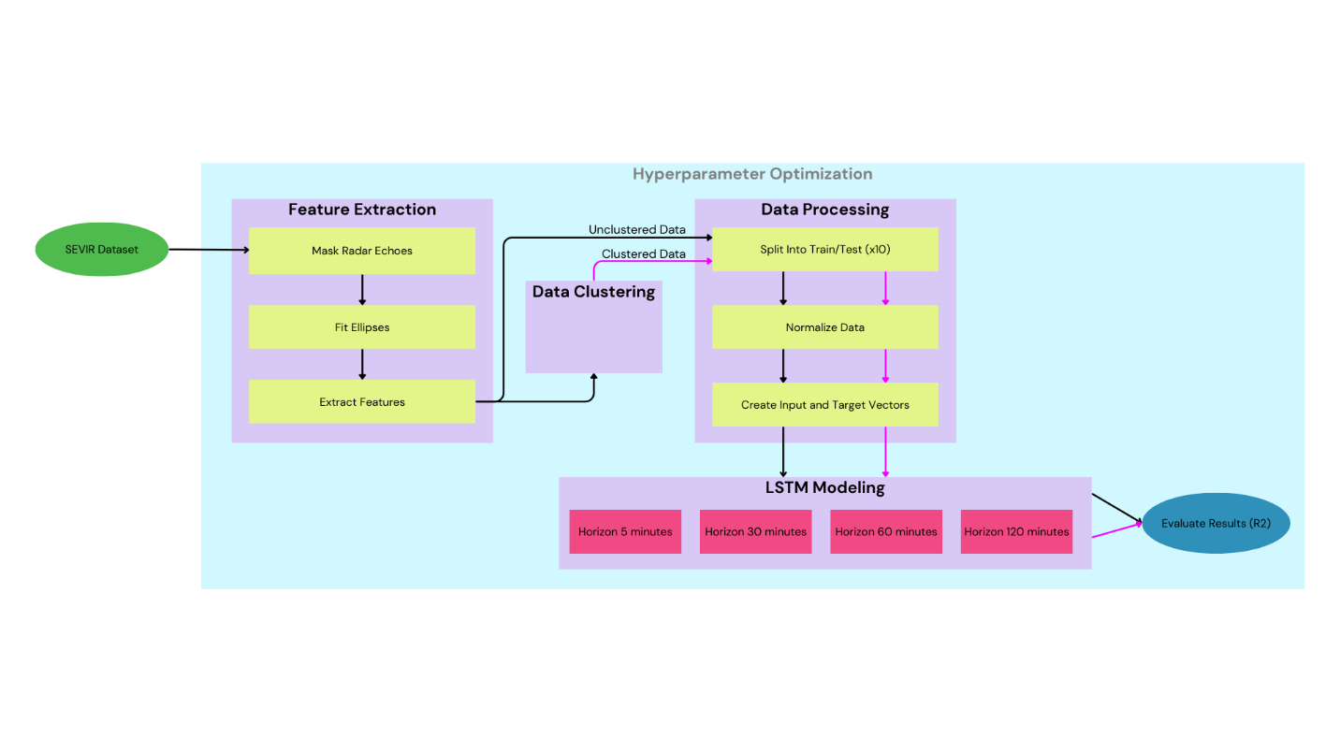
Methodology Overview

Slide 18
Methodology – The SEVIR Dataset

Slide 19
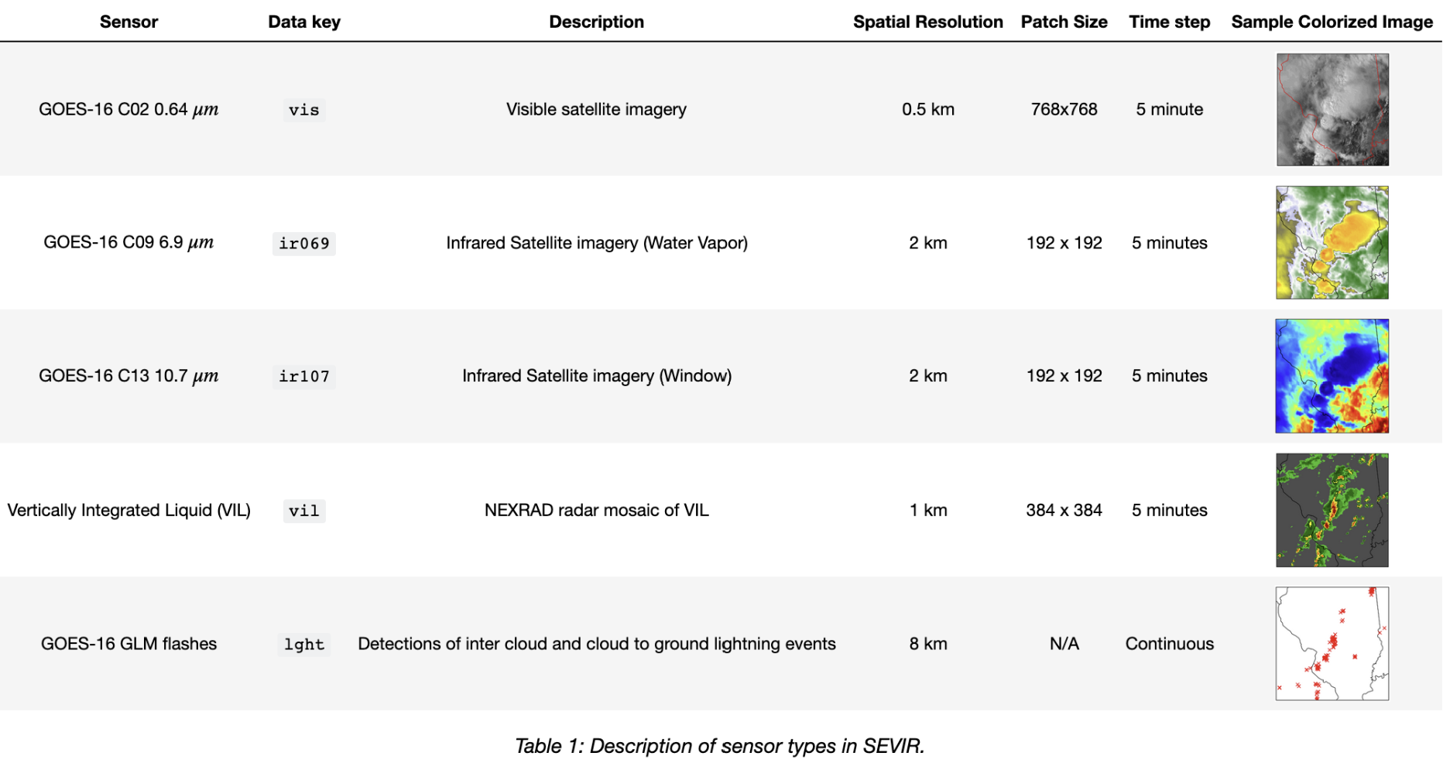
Methodology – The SEVIR Dataset
Notes:
Storm EVent ImageRy
Dataset created with partnership between the USAF, MIT, and MIT Lincoln Labs
10,000 weather events across CONUS
Only Utilized VIL Sensor Modality
Represents amount of liquid precipitation present in a column of atmosphere

Slide 20
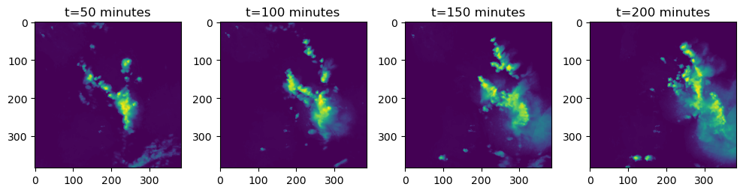
Methodology – The SEVIR Dataset
20,723 sequences of vil data
Total sequence length of 4 hours (49 frames)
Notes:
20,273 sets of image sequences in this modality
Encoded from kg/m² to an integer range of 0-255 for more efficient storage
Value of 255 used for missing data
Referring to radar “echoes” – Because images show the reflection or “echo” of radar off of precipitation in the atmosphere
Covered a 384x384 km patch of land with each pixel representing 1 sq. km

Slide 21
Methodology – Feature Extraction

Slide 22
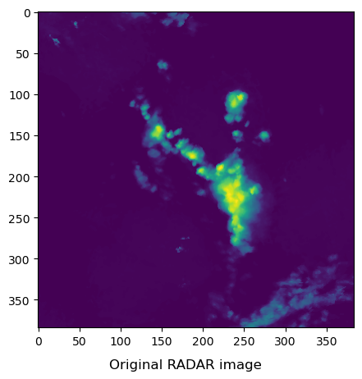
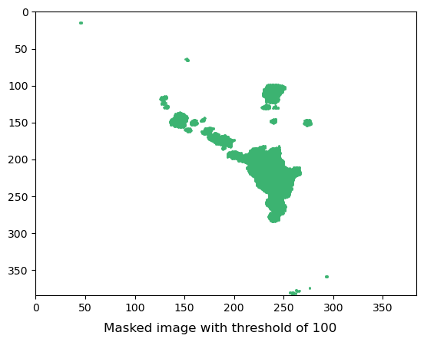
Feature Extraction – Radar Masking
Required for ellipse fitting
Flattened echoes, converting from 0-255 range to binary 0 or 1
Notes:
Masking necessary to compute covariance matrix

Slide 23
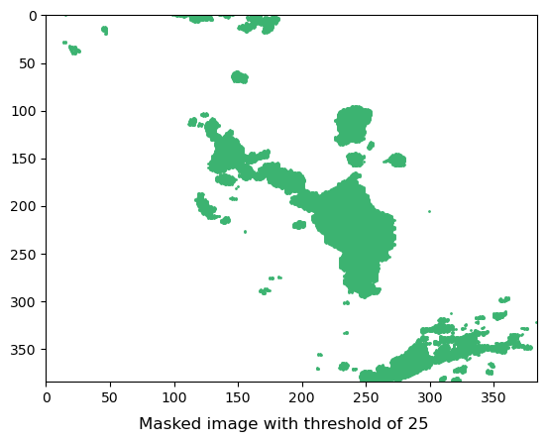
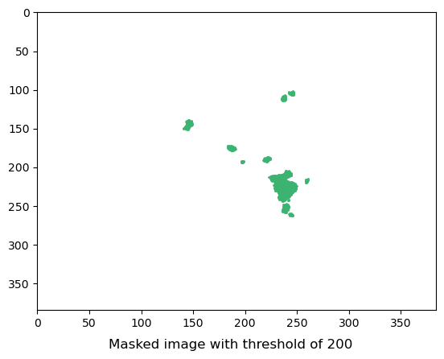
Feature Extraction – Radar Masking
Masked radar echoes using a masking threshold
Varied threshold produced varying results
Notes:
Used masking threshold to capture main body of storm without outlying segments
Attempted to optimize masking threshold (will talk about later)

Slide 24

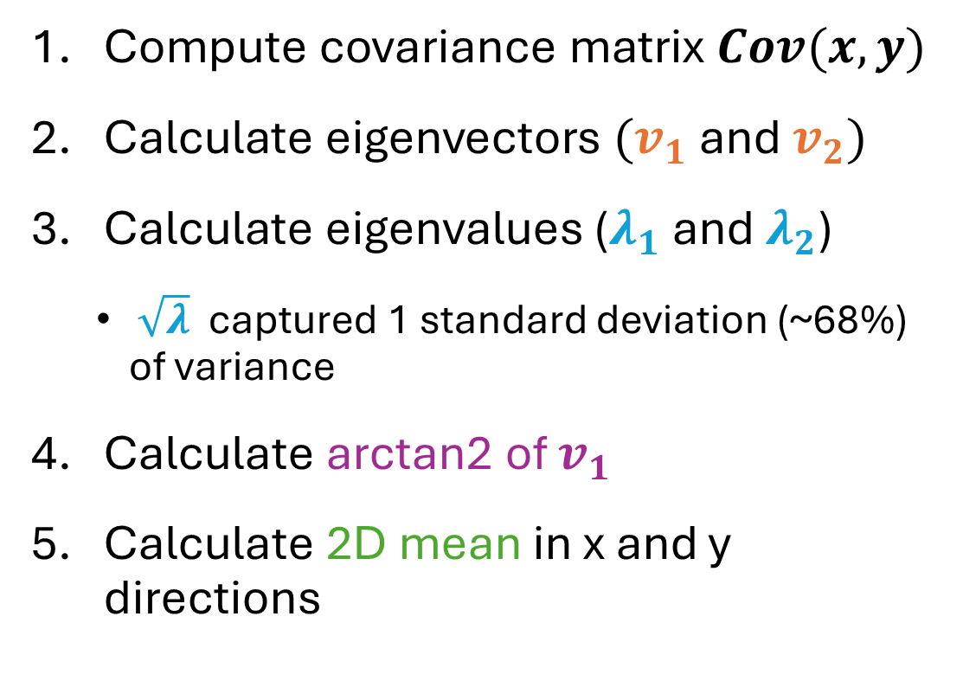




Feature Extraction – Fitting Ellipses
Compute covariance matrix $Cov(x,y)$
Calculate eigenvectors $(v_{1}$ and $v_{2})$
Calculate eigenvalues ($λ_{1}$ and $λ_{2}$)
$\sqrt{λ}$ captured 1 standard deviation (~68%) of variance
Calculate arctan2 of $v_{1}$
Calculate 2D mean in x and y directions
$v_{2}$
$v_{1}$
$$λ_{2}$$
$λ_{1}$
arctan2${(v}_{1})$
2D mean
Notes:
$Cov(x,y)$ gives information about the spread and direction of a storm in the $x$ and $y$ axes.
($v_{1}$ and $v_{2}$) of $Cov\left(x,y\right)$ are the 2 greatest directions of variance (the principal directions)
Always orthogonal
They represent the directions of the semi-major and semi-minor axes of a storm ellipse.
eigenvalues ($λ_{1}$ and $λ_{2}$) of $Cov(x,y)$ represent the magnitude of $v_{1}$ and $v_{2}$

Slide 25

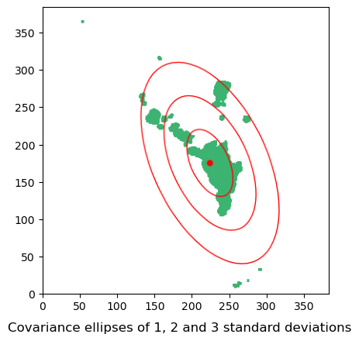
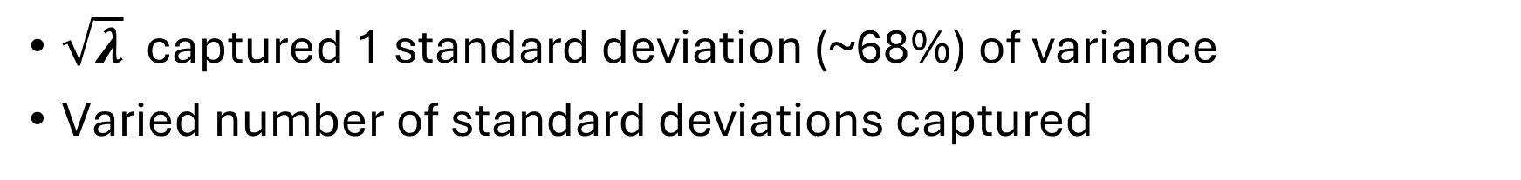
Feature Extraction – Ellipse Fitting
$\sqrt{λ}$ captured 1 standard deviation (~68%) of variance
Varied number of standard deviations captured
Notes:
1, 2, and 3 standard deviations (68%, 95%, and 99%)

Slide 26
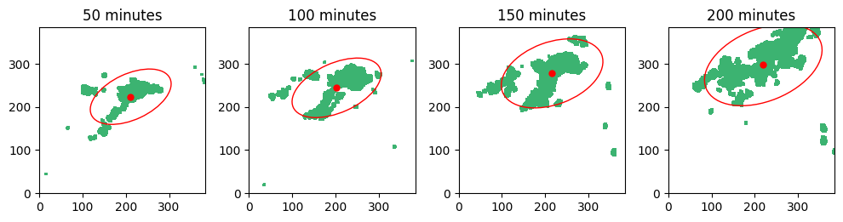
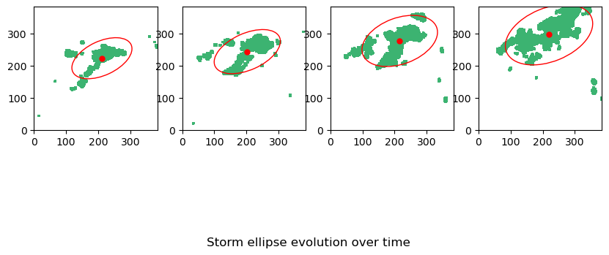
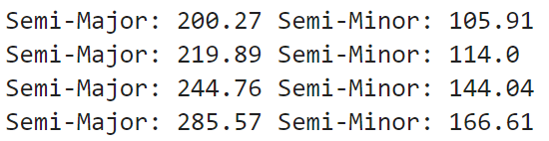
Feature Extraction – Ellipse Fitting
View evolution of this ellipse over time

Slide 27
Feature Extraction – Other 1st Order Features
Ellipse area
Axis ratio
Intensity
Arithmetic mean of pixel values in radar echo meeting mask threshold
Average
Intensity/Area

Slide 28
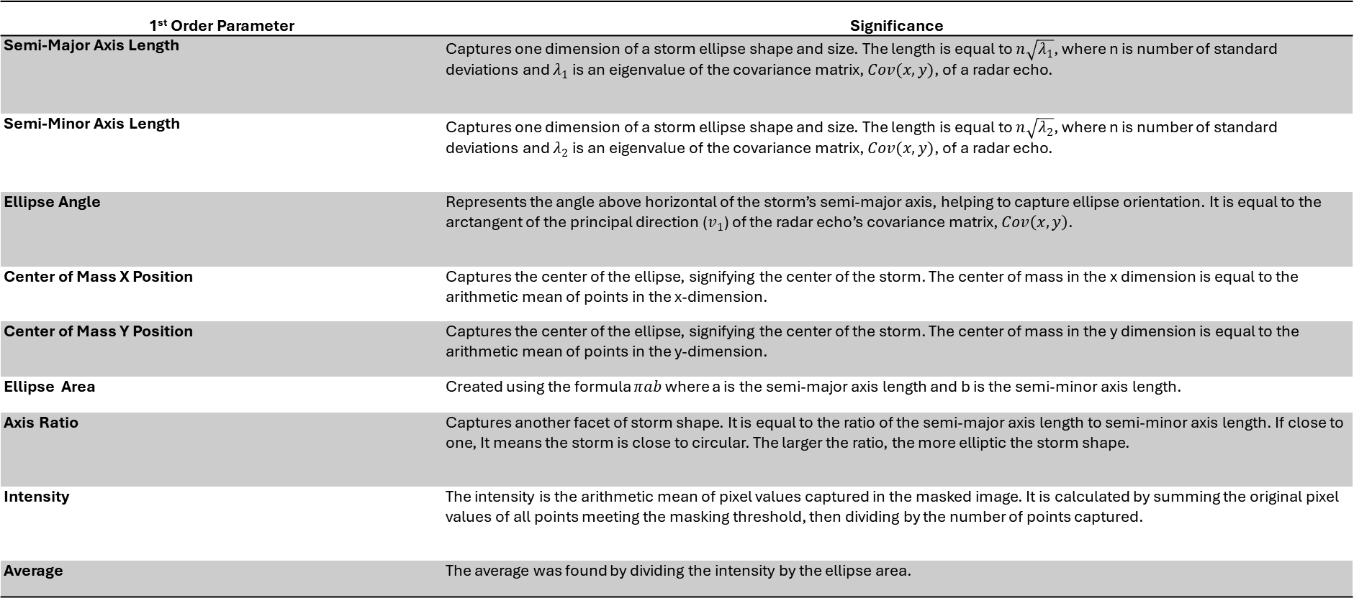
Feature Extraction – 1st Order Features
1st Order Parameter | Significance
Semi-Major Axis Length | Captures one dimension of a storm ellipse shape and size. The length is equal to $n\sqrt{λ_{1}}$, where n is number of standard deviations and $λ_{1}$ is an eigenvalue of the covariance matrix, $Cov(x,y)$, of a radar echo.
Semi-Minor Axis Length | Captures one dimension of a storm ellipse shape and size. The length is equal to $n\sqrt{λ_{2}}$, where n is number of standard deviations and $λ_{2}$ is an eigenvalue of the covariance matrix, $Cov(x,y)$, of a radar echo.
Ellipse Angle | Represents the angle above horizontal of the storm’s semi-major axis, helping to capture ellipse orientation. It is equal to the arctangent of the principal direction ($v_{1}$) of the radar echo’s covariance matrix, $Cov\left(x,y\right)$.
Center of Mass X Position | Captures the center of the ellipse, signifying the center of the storm. The center of mass in the x dimension is equal to the arithmetic mean of points in the x-dimension.
Center of Mass Y Position | Captures the center of the ellipse, signifying the center of the storm. The center of mass in the y dimension is equal to the arithmetic mean of points in the y-dimension.
Ellipse Area | Created using the formula $πab$ where a is the semi-major axis length and b is the semi-minor axis length.
Axis Ratio | Captures another facet of storm shape. It is equal to the ratio of the semi-major axis length to semi-minor axis length. If close to one, It means the storm is close to circular. The larger the ratio, the more elliptic the storm shape.
Intensity | The intensity is the arithmetic mean of pixel values captured in the masked image. It is calculated by summing the original pixel values of all points meeting the masking threshold, then dividing by the number of points captured.
Average | The average was found by dividing the intensity by the ellipse area.

Slide 29
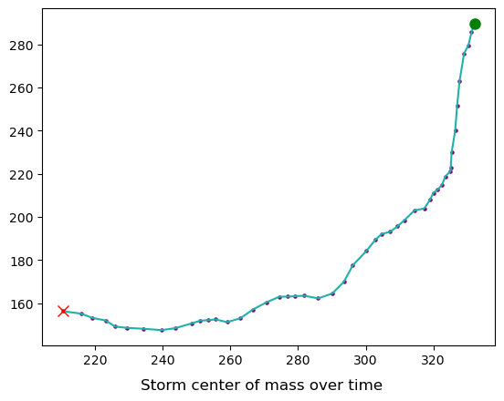
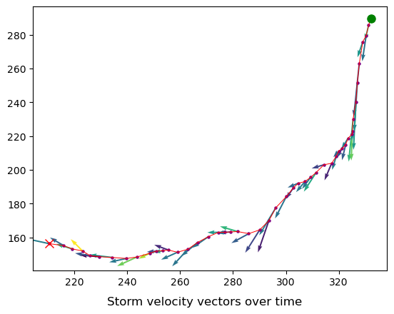
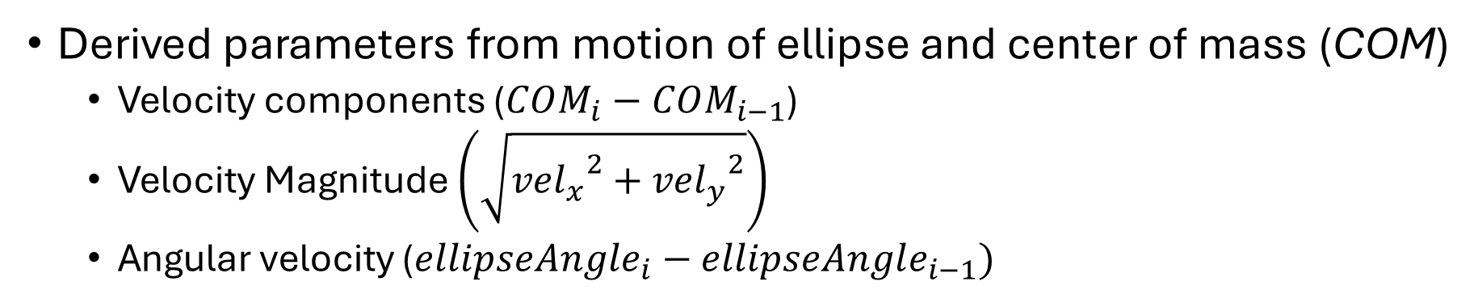
Feature Extraction – Deriving 2nd Order Features
Derived parameters from motion of ellipse and center of mass (COM)
Velocity components ($COM_{i}−COM_{i−1}$)
Velocity Magnitude $\left(\sqrt{{{vel}_{x}}^{2}+{{vel}_{y}}^{2}}\right)$
Angular velocity ($ellipseAngle_{i}−ellipseAngle_{i−1})$
Notes:
1st order finite differencing (backward differencing)
Common simple method for approximating derivatives
Subtracted previous frame’s value from current value

Slide 30
Feature Extraction: Features
Final set of 13 features
1st Order Features | 2nd Order Features
Center of Mass (x component) | Velocity (x component)
Center of Mass (y component) | Velocity (y component)
Semi-Major Axis Length | Velocity (magnitude)
Semi-Minor Axis Length | Angular Velocity
Ellipse Area
Ellipse Angle
Axis Ratio
Intensity
Average
Notes:
First frame of every sequence removed after feature extraction because no 2nd order features could be calculated
New sequence length of 48 frames (3 hours, 55 minutes)
NOTE: Intensity should be renamed to average. Average should be renamed to non-zero pixel average.

Slide 31
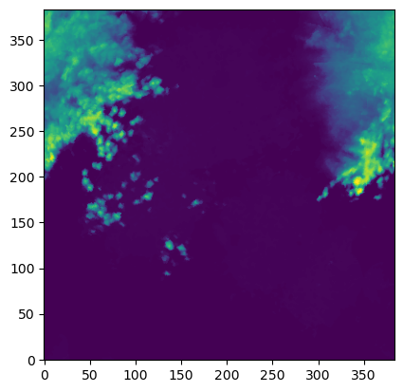
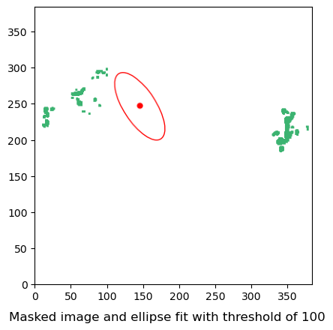
Feature Extraction: Issues Encountered
Assumed elliptical storm shape

Slide 32
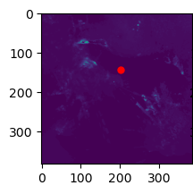
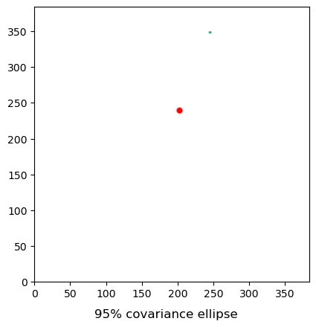
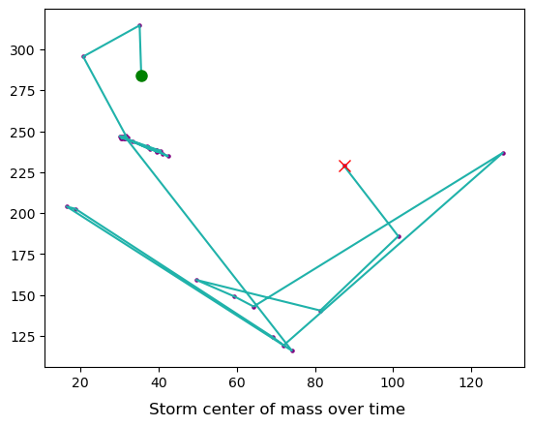
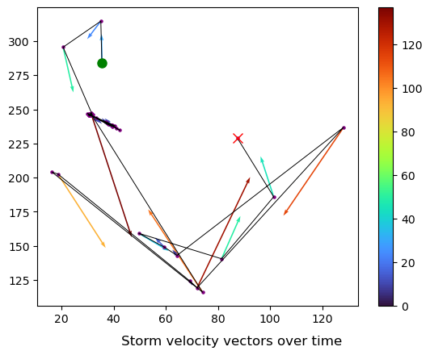
Feature Extraction: Issues Encountered
Low intensity storms were removed from dataset
Still remained a large dataset
Notes:
R17091202058422

Slide 33
Methodology – Data Clustering

Slide 34
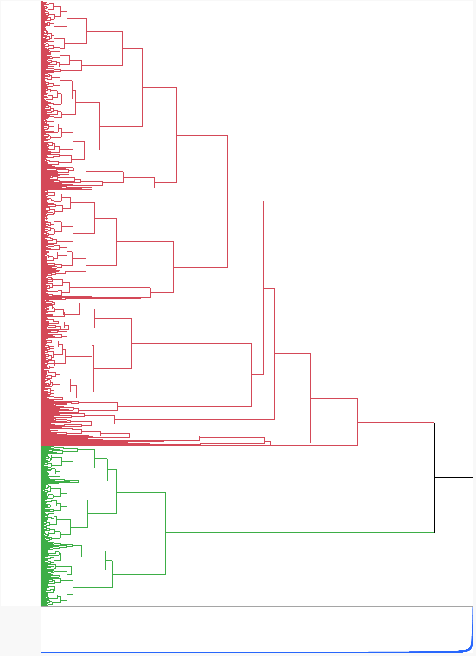
Data Processing: Attempted Clustering
Extracted 1st frame from every sequence
Clustered into 2 groups
Used agglomerative hierarchical clustering
Notes:
agglomerative hierarchical clustering – from the bottom up (starts with clusters of 1, then groups most similar clusters)
Dendrogram is shown
Storms may exist is hierarchies of types/subtypes
Also just gave me the best results
From here on, applied everything to both clustered data groups and unclustered data gruops

Slide 35
Methodology – Data Processing
Notes:
From here on, applied everything to both clustered data groups and unclustered data gruops

Slide 36
Data Processing – Splitting the Data
Used 10 distinct train/test splits for each dataset created
80% training, 20% testing data
Masking Threshold | Number of samples in dataset
114 | 14221
65 | 16664
50 | 17236
Notes:
From here on, applied everything to both clustered data groups and unclustered data gruops
Higher masking threshold meant more samples were thrown out due to low intensities

Slide 37
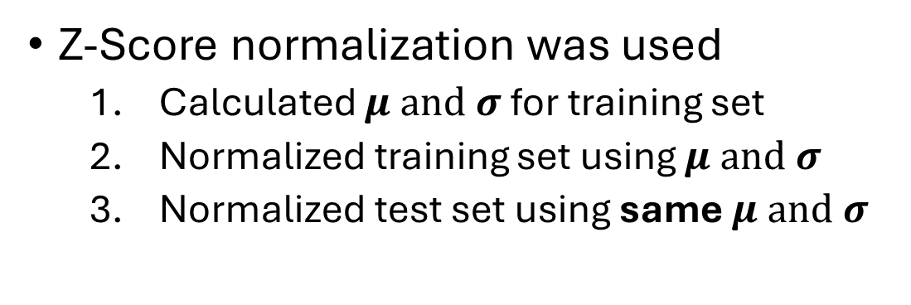
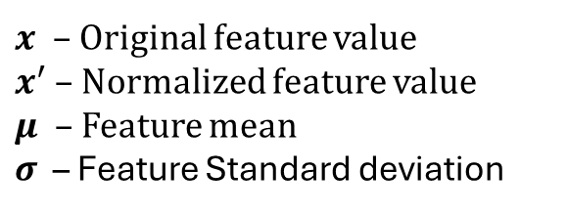
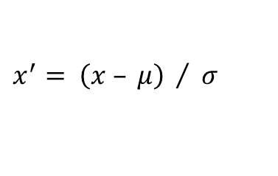
Data Processing – Normalizing the Data
Z-Score normalization was used
Calculated $μ$ and $σ$ for training set
Normalized training set using $μ$ and $σ$
Normalized test set using same $μ$ and $σ$
 | Min | Max | Range | Mean | Std
Semi Major Axis Length | 3.58448 | 517.79757 | 514.213088 | 182.033 | 54.1385
Semi Minor Axis Length | 3.00645 | 279.70372 | 276.697275 | 90.2327 | 38.5097
Area | 34.7623 | 255054.61 | 255019.8507 | 54455.2 | 31355.1
Axis Ratio | 1.00126 | 113.77811 | 112.776843 | 2.42512 | 1.78139
Ellipse Angle | -179.998 | 179.99996 | 359.998005 | 20.2367 | 123.344
COMX | 1.56495 | 380.89471 | 379.329763 | 190.864 | 62.1156
COMY | 2.01168 | 380.89545 | 378.883768 | 194.686 | 64.3451
Intensity | 101.741 | 254.97469 | 153.23395 | 131.219 | 14.8513
Average | 0.63397 | 364583.97 | 364583.3372 | 112.581 | 1186.3
Velocity X | -290.128 | 281.56855 | 571.696645 | -0.04336 | 6.37419
Velocity Y | -275.143 | 260.68363 | 535.826272 | 1.08068 | 6.41762
Velocity Magnitude | 0 | 371.54312 | 371.543115 | 5.51097 | 7.25363
Angular Velocity | -359.953 | 359.97356 | 719.926181 | -0.02068 | 49.8969
$$x^{′}= \left(x – μ\right) / σ$$
$x$ – Original feature value
$x^{′}$ – Normalized feature value
$μ$ – Feature mean
$σ$ – Feature Standard deviation
Notes:
Mean = 0,
Standard dev. = 1
Important to normalize train set first, then test set using same metric to preserve “unseen” nature of test set
Would otherwise introduce bias into model and possible skew results to being too optimistic

Slide 38
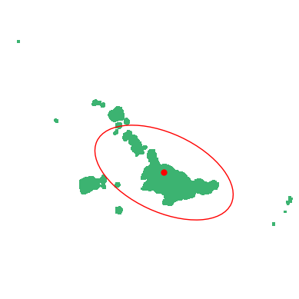
Data Processing: Creating Inputs and Targets
LSTM Input
LSTM Output
Sequence of data frames (every 5 minutes)
Single future data frame (+5 to +120 minutes)

Slide 39
Data Processing: Creating Inputs and Targets
Rolling Window Technique
Input/Target Pair 1
Input/Target Pair 2
Input/Target Pair 3
Entire Weather Event Sequence
Input Sequence
Prediction Horizon
Prediction Target Frame
Notes:
Number of samples per event sequence dependent on Input Sequence length and Horizon Length

Slide 40
Methodology – LSTM Modeling

Slide 41
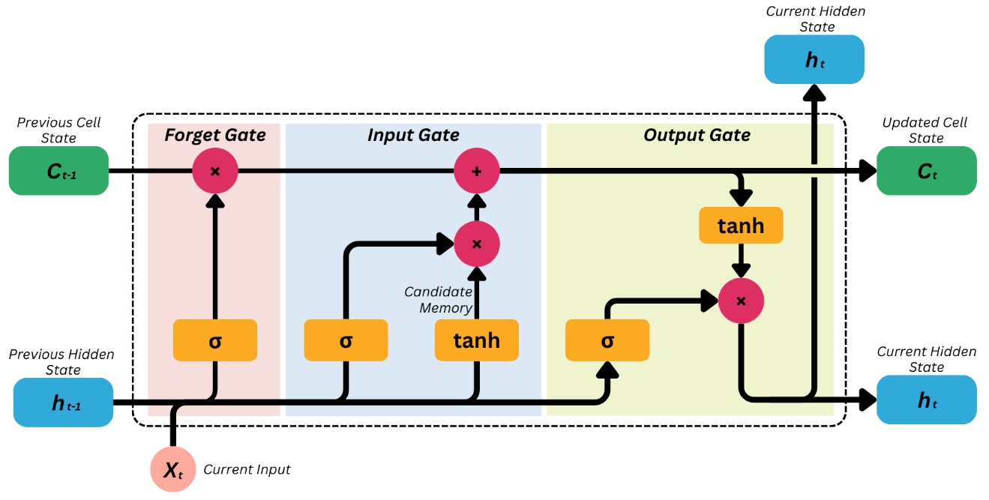
LSTM Modeling - LSTM Background
Cell State: Long term memory
Hidden State: Short term memory
Notes:
Forget gate controls how much of the cell state (long term memory) to remember for the current input.
Input gate controls how new information coming into the lstm cell (candidate information) is incorporated into the cell state.
Output gate controls the lstm cell’s output, which is the hidden state
Filters cell state and previous hidden state.
Candidate gate (sometimes referred to as candidate memory or the input modulation gate). After the input gate tanh function, candidate memory is proposed to update the cell state.

Slide 42
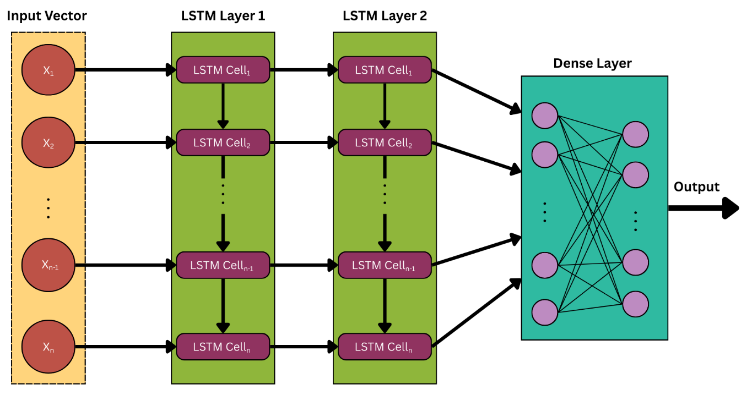
LSTM Modeling - LSTM Architecture
Dropout of 0.20 Applied
Notes:
1 LSTM Cell per input sequence timestep, each with hidden state size of 32
2 LSTM layers
Dense layer to convert from hidden state dimensionality of 32 to feature dimensionality of 13
Dropout of 0.20 applied to LSTM layers to avoid overfitting

Slide 43
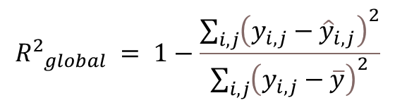
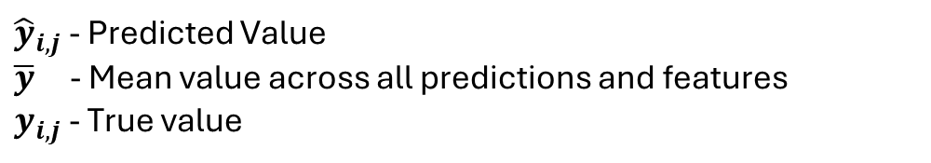
LSTM Modeling - LSTM Training and Evaluation
Separate Model for each time horizon (5, 30, 60, 120 minutes)
Loss Function: Mean Squared Error (MSE)
Evaluation Metric: R²
Global R²
Per-Feature R²
$${R^{2}}_{global} = 1−\frac{\sum_{i,j}{{\left(y_{i,j}−{\hat{y}}_{i,j}\right)}^{2}}}{\sum_{i,j}{{\left(y_{i,j}−\overline{y}\right)}^{2}}}$$
${\hat{y}}_{i,j}$ - Predicted Value
$\overline{y}$ - Mean value across all predictions and features
$y_{i,j}$ - True value
Notes:
Started off using tensorlow, then switched to PyTorch
Also used numpy and scipy quite a bit

Slide 44
Methodology – Hyperparameter Optimization

Slide 45
Hyperparameter Optimization
3 hyperparameters considered for optimization
Masking Threshold
Number of standard deviations captured during ellipse fitting
Input Sequence Length
Each horizon length may have a distinct optimal combination

Slide 46
Parameter Tuning
Used Near-Orthogonal Latin Hypercubes for sampling design space
Evenly samples a design space
Minimizes correlation between subspaces
Notes:
Latin hypercube - aims to evenly sample a design space.
The design space for this study was composed of three subspaces, one for each hyperparameter.
Orthogonal latin hypercube sampling - each subspace is orthogonal.
If orthogonal, no correlation between subspaces.
NOLHs minimizes correlation between subspaces while maintaining flexibility and efficiency in the sampling design

Slide 47
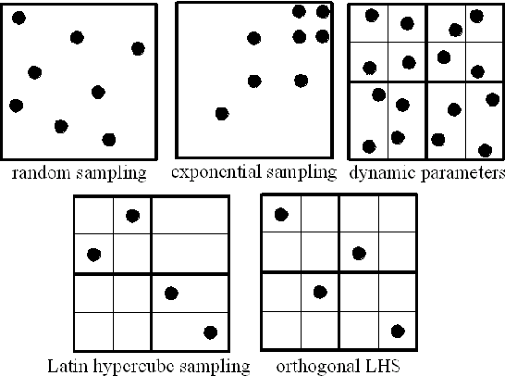
Parameter Tuning
Used Near-Orthogonal Latin Hypercubes for sampling design space
Evenly samples a design space
Minimizes correlation between subspaces
Holder, Robert. “Improving a Plan Library for Real-time Systems Using Nearly Orthogonal Latin Hypercube Sampling.” AAAI Conference on Artificial Intelligence (2008).
Notes:
Image Source: https://www.semanticscholar.org/paper/Improving-a-Plan-Library-for-Real-time-Systems-Holder/165aa205befa6bb1a044d636fd356d5e946cf01d

Slide 48
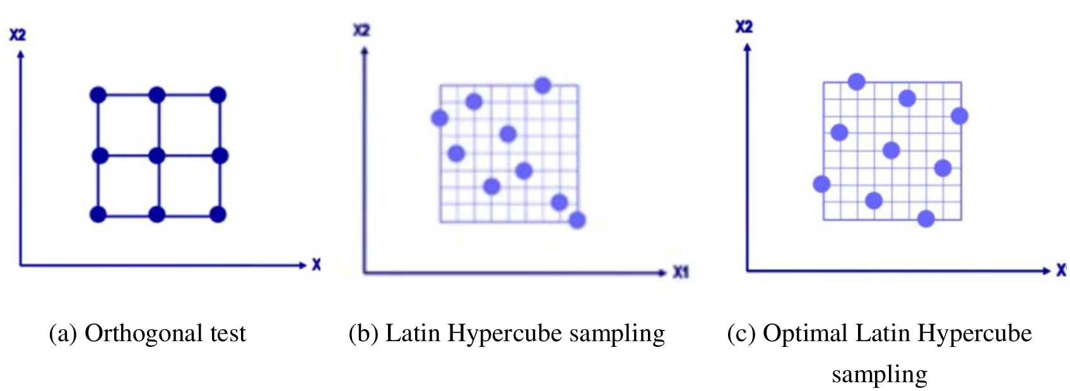
Hyperparameter Optimization - NOLHs
Used Near-Orthogonal Latin Hypercubes for sampling design space
Evenly samples a design space
Minimizes correlation between subspaces
Wang H, Yu C, Zhu X, Jian L, Lu C, Pan X (2024) Elevator block brake structural optimization design based on an approximate model. PLoS ONE 19(3): e0296753. https://doi.org/10.1371/journal.pone.0296753

Slide 49
Hyperparameter Optimization – Sampling
Used preliminary analysis on masking threshold and logical values to bound initial design space
Initial Design Space Bounds
 | Masking Threshold | Number of Standard Deviations | Input Sequence Length
Min | 50 | 1 | 1
Max | 150 | 3 | 24
Notes:
Latin hypercube - aims to evenly sample a design space.
The design space for this study was composed of three subspaces, one for each hyperparameter.
Orthogonal latin hypercube sampling - each subspace is orthogonal.
If orthogonal, no correlation between subspaces.
NOLHs minimizes correlation between subspaces while maintaining flexibility and efficiency in the sampling design

Slide 50
Hyperparameter Optimization – Sampling
Used NOLH to pick 17 design points
 | Masking Threshold | Number of Standard Deviations | Input Sequence Length
Design Point 1 | 81 | 3 | 20
Design Point 2 | 56 | 1.5 | 21
Design Point 3 | 63 | 1.9 | 2
Design Point 4 | 69 | 2.3 | 8
Design Point 5 | 125 | 2.9 | 11
Design Point 6 | 150 | 1.6 | 10
Design Point 7 | 113 | 1.4 | 24
Design Point 8 | 106 | 2.8 | 18
Design Point 9 | 100 | 2 | 13
Design Point 10 | 119 | 1 | 5
Design Point 11 | 144 | 2.5 | 4
Design Point 12 | 138 | 2.1 | 23
Design Point 13 | 131 | 1.8 | 17
Design Point 14 | 75 | 1.1 | 14
Design Point 15 | 50 | 2.4 | 15
Design Point 16 | 88 | 2.6 | 1
Design Point 17 | 94 | 1.3 | 7
Initial Design Space Bounds
 | Masking Threshold | Number of Standard Deviations | Input Sequence Length
Min | 50 | 1 | 1
Max | 150 | 3 | 24
Notes:
17 design points is a commonly used number in NOLH design

Slide 51
Hyperparameter Optimization
Bounded design space and sampled design points
Created data, trained, and evaluated models for each design point
Fit regression model to R² values w.r.t each hyperparameter
Create new bounds for design space based on results
Repeat
Notes:
Used stepwise linear regression with 2nd order response surface to create parsimonious model (disregard irrelevant features)
Optimize to find optimal value of each hyperparameter
Used JMP software

Slide 52
Results and Analysis

Slide 53
Results – Hyperparameter Optimization
No relationship between input sequence length and model performance
Standard deviations included in ellipse formation was always optimal at lower bound of design space
Masking threshold became irrelevant as a result

Slide 54
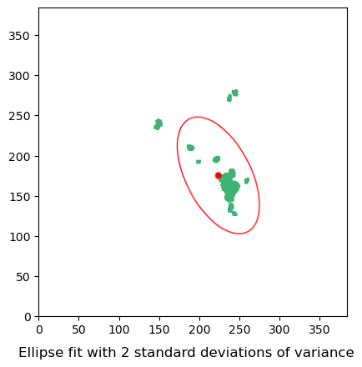
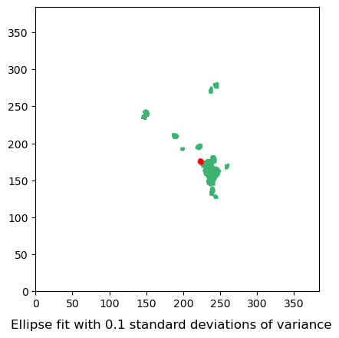
Results – Hyperparameter Optimization
Other features were heavily influenced by standard deviations
Semi-Major: 200.27
Semi-Minor: 105.91
Semi-Major: 8.21
Semi-Minor: 4.21
Notes:
As STDs decreased, so did ellipse size.
Small ellipse size affected other 1st order features.
Less variance/range
The smaller variance and ranges affected model learning in a positive way, even after normalization (if negligibly ie ~0.02-0.07 for R²)
Explains why STD consistently optimized to its lower bound

Slide 55
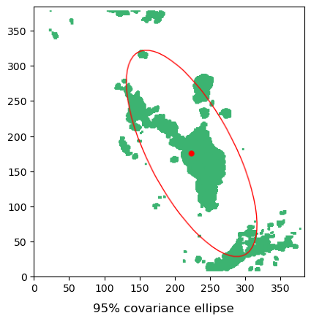
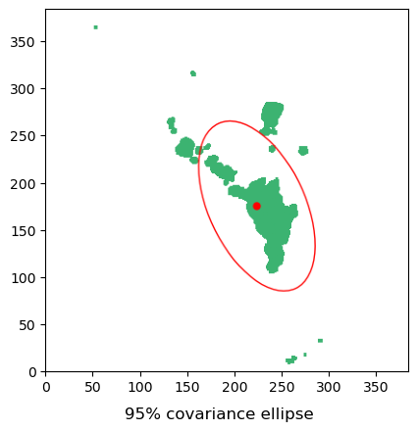
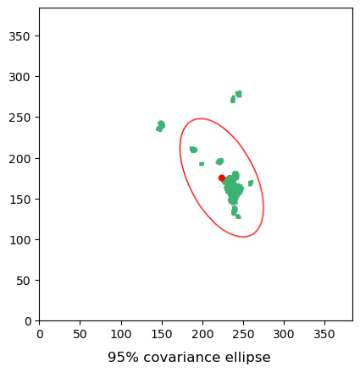
Results – Hyperparameter Optimization
With larger standard deviation values, ellipse size varied greatly depending on masking threshold
Notes:
Getting into why the masking threshold became irrelevant

Slide 56

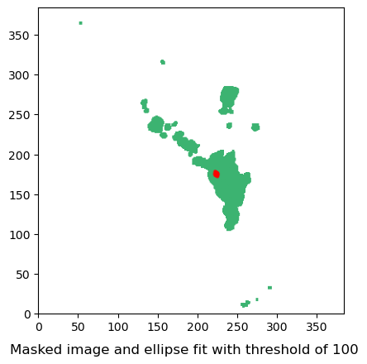
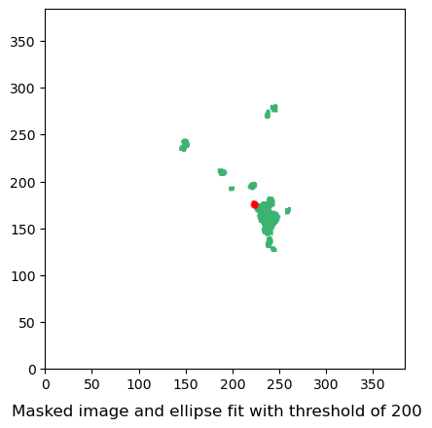
Results – Hyperparameter Optimization
With smaller values for standard deviations, masking threshold became irrelevant
Notes:
Masking threshold was introduced to disregard disjoint storm portions and capture only the main body
With small standard deviations, the portions of storm being ignored had negligible impact on ellipse formation

Slide 57
Results – Hyperparameter Optimization
Results for standard deviation were an artifact of model evaluation methods
Resulted in poor storm representation in ellipses
Value was set to 1 to create final set of optimal hyperparameters with NOLH
Final Hyperparameter Combinations
 | Masking Threshold | Number STD | Input Sequence Length
5 minute horizon | 114 | 1 | 8
30 minute horizon | 65 | 1 | 4
60 minute horizon | 50 | 1 | 9
120 minute horizon | 50 | 1 | 13
Notes:
These optimized parameters were used for unclustered and clustered data for final analysis

Slide 58
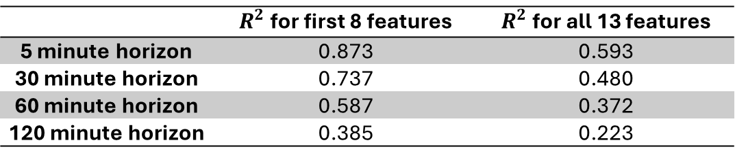
Results – Model Accuracy
Model accuracy decreased as horizon increased
Large gap in performance between first 8 parameters and final 5 parameters
 | $R^{2}$ for first 8 features | $R^{2}$ for all 13 features
5 minute horizon | 0.873 | 0.593
30 minute horizon | 0.737 | 0.480
60 minute horizon | 0.587 | 0.372
120 minute horizon | 0.385 | 0.223
Notes:
Smaller changes are easier to predict than larger ones.
With longer horizons, there is more time deviation from expected patterns.
If a deviation does occur, it is given more time to propagate, causing larger difference

Slide 59

Results – Model Accuracy
Results followed the same pattern for all horizons
 | 5 minute horizon $R^{2}$ | 30 minute horizon $R^{2}$ | 60 minute horizon $R^{2}$ | 120 minute horizon $R^{2}$
COMX | 0.939 | 0.8974 | 0.7861 | 0.5564
COMY | 0.941 | 0.8986 | 0.7972 | 0.5373
Area | 0.921 | 0.8185 | 0.6326 | 0.4237
Semi Major Axis Length | 0.891 | 0.7082 | 0.4828 | 0.2594
Semi Minor Axis Length | 0.909 | 0.8055 | 0.6318 | 0.4336
Axis Ratio | 0.772 | 0.5535 | 0.3773 | 0.2035
Ellipse Angle | 0.795 | 0.5708 | 0.3841 | 0.1824
Intensity | 0.846 | 0.708 | 0.5621 | 0.4768
Average | 0.077 | 0.1059 | 0.0109 | 0.0002
Velocity X | 0.042 | 0.0111 | 0.0076 | 0.0015
Velocity Y | 0.076 | 0.0172 | 0.0103 | 0.0053
Velocity Magnitude | 0.265 | 0.2084 | 0.1884 | 0.1389
Angular Velocity | 0.040 | 0.0017 | -0.0002 | -0.0006

Slide 60

Results – Model Accuracy
COMs performed the best overall with Intensity close behind
Also had the smallest drop across horizons
 | 5 minute horizon $R^{2}$ | 30 minute horizon $R^{2}$ | 60 minute horizon $R^{2}$ | 120 minute horizon $R^{2}$
COMX | 0.939 | 0.8974 | 0.7861 | 0.5564
COMY | 0.941 | 0.8986 | 0.7972 | 0.5373
Area | 0.921 | 0.8185 | 0.6326 | 0.4237
Semi Major Axis Length | 0.891 | 0.7082 | 0.4828 | 0.2594
Semi Minor Axis Length | 0.909 | 0.8055 | 0.6318 | 0.4336
Axis Ratio | 0.772 | 0.5535 | 0.3773 | 0.2035
Ellipse Angle | 0.795 | 0.5708 | 0.3841 | 0.1824
Intensity | 0.846 | 0.708 | 0.5621 | 0.4768
Average | 0.077 | 0.1059 | 0.0109 | 0.0002
Velocity X | 0.042 | 0.0111 | 0.0076 | 0.0015
Velocity Y | 0.076 | 0.0172 | 0.0103 | 0.0053
Velocity Magnitude | 0.265 | 0.2084 | 0.1884 | 0.1389
Angular Velocity | 0.040 | 0.0017 | -0.0002 | -0.0006

Slide 61

Results – Model Accuracy
Area and axis lengths trailed COM close at horizon of 5 minutes
Gap widened as horizon increased
Gap between semi-major and semi-minor axes also widened with larger horizon
 | 5 minute horizon $R^{2}$ | 30 minute horizon $R^{2}$ | 60 minute horizon $R^{2}$ | 120 minute horizon $R^{2}$
COMX | 0.939 | 0.8974 | 0.7861 | 0.5564
COMY | 0.941 | 0.8986 | 0.7972 | 0.5373
Area | 0.921 | 0.8185 | 0.6326 | 0.4237
Semi Major Axis Length | 0.891 | 0.7082 | 0.4828 | 0.2594
Semi Minor Axis Length | 0.909 | 0.8055 | 0.6318 | 0.4336
Axis Ratio | 0.772 | 0.5535 | 0.3773 | 0.2035
Ellipse Angle | 0.795 | 0.5708 | 0.3841 | 0.1824
Intensity | 0.846 | 0.708 | 0.5621 | 0.4768
Average | 0.077 | 0.1059 | 0.0109 | 0.0002
Velocity X | 0.042 | 0.0111 | 0.0076 | 0.0015
Velocity Y | 0.076 | 0.0172 | 0.0103 | 0.0053
Velocity Magnitude | 0.265 | 0.2084 | 0.1884 | 0.1389
Angular Velocity | 0.040 | 0.0017 | -0.0002 | -0.0006
Notes:
Indicates the model had much more difficulty predicting the semi major axis as horizon length grew when relative to other features

Slide 62

Results – Model Accuracy
Area and semi-minor axis length mirrored performances
Axis ratio and ellipse angle also mirrored performances
Large gap separating them from axis length R² values
 | 5 minute horizon $R^{2}$ | 30 minute horizon $R^{2}$ | 60 minute horizon $R^{2}$ | 120 minute horizon $R^{2}$
COMX | 0.939 | 0.8974 | 0.7861 | 0.5564
COMY | 0.941 | 0.8986 | 0.7972 | 0.5373
Area | 0.921 | 0.8185 | 0.6326 | 0.4237
Semi Major Axis Length | 0.891 | 0.7082 | 0.4828 | 0.2594
Semi Minor Axis Length | 0.909 | 0.8055 | 0.6318 | 0.4336
Axis Ratio | 0.772 | 0.5535 | 0.3773 | 0.2035
Ellipse Angle | 0.795 | 0.5708 | 0.3841 | 0.1824
Intensity | 0.846 | 0.708 | 0.5621 | 0.4768
Average | 0.077 | 0.1059 | 0.0109 | 0.0002
Velocity X | 0.042 | 0.0111 | 0.0076 | 0.0015
Velocity Y | 0.076 | 0.0172 | 0.0103 | 0.0053
Velocity Magnitude | 0.265 | 0.2084 | 0.1884 | 0.1389
Angular Velocity | 0.040 | 0.0017 | -0.0002 | -0.0006
Notes:
Indicates the model had much more difficulty predicting the semi major axis as horizon length grew when relative to other features

Slide 63

Results – Model Accuracy
The remaining features had a drastic drop in results
 | 5 minute horizon $R^{2}$ | 30 minute horizon $R^{2}$ | 60 minute horizon $R^{2}$ | 120 minute horizon $R^{2}$
COMX | 0.939 | 0.8974 | 0.7861 | 0.5564
COMY | 0.941 | 0.8986 | 0.7972 | 0.5373
Area | 0.921 | 0.8185 | 0.6326 | 0.4237
Semi Major Axis Length | 0.891 | 0.7082 | 0.4828 | 0.2594
Semi Minor Axis Length | 0.909 | 0.8055 | 0.6318 | 0.4336
Axis Ratio | 0.772 | 0.5535 | 0.3773 | 0.2035
Ellipse Angle | 0.795 | 0.5708 | 0.3841 | 0.1824
Intensity | 0.846 | 0.708 | 0.5621 | 0.4768
Average | 0.077 | 0.1059 | 0.0109 | 0.0002
Velocity X | 0.042 | 0.0111 | 0.0076 | 0.0015
Velocity Y | 0.076 | 0.0172 | 0.0103 | 0.0053
Velocity Magnitude | 0.265 | 0.2084 | 0.1884 | 0.1389
Angular Velocity | 0.040 | 0.0017 | -0.0002 | -0.0006
Notes:
Average was the only 1st order feature included in these

Slide 64
Results – Model Accuracy
Velocity magnitude had slightly higher performance
Near-zero R² values is slightly better than predicting arithmetic mean
 | 5 minute horizon $R^{2}$ | 30 minute horizon $R^{2}$ | 60 minute horizon $R^{2}$ | 120 minute horizon $R^{2}$
COMX | 0.939 | 0.8974 | 0.7861 | 0.5564
COMY | 0.941 | 0.8986 | 0.7972 | 0.5373
Area | 0.921 | 0.8185 | 0.6326 | 0.4237
Semi Major Axis Length | 0.891 | 0.7082 | 0.4828 | 0.2594
Semi Minor Axis Length | 0.909 | 0.8055 | 0.6318 | 0.4336
Axis Ratio | 0.772 | 0.5535 | 0.3773 | 0.2035
Ellipse Angle | 0.795 | 0.5708 | 0.3841 | 0.1824
Intensity | 0.846 | 0.708 | 0.5621 | 0.4768
Average | 0.077 | 0.1059 | 0.0109 | 0.0002
Velocity X | 0.042 | 0.0111 | 0.0076 | 0.0015
Velocity Y | 0.076 | 0.0172 | 0.0103 | 0.0053
Velocity Magnitude | 0.265 | 0.2084 | 0.1884 | 0.1389
Angular Velocity | 0.040 | 0.0017 | -0.0002 | -0.0006
Notes:
Indicates the model had much more difficulty predicting the semi major axis as horizon length grew when relative to other features

Slide 65






Results – Model Accuracy
Poor performance in final 5 features is due to the nature of the features
Notes:
Final 5 features are extremely volatile compared to other features
Local volatility makes prediction difficult if not impossible
Some show overall trend, but local prediction still difficult
May still provide useful information in long term memory though

Slide 66

Results – Clustered Model Accuracy
Clustering had negligible impact on results
Clusters were still extremely large
May still have contained unique storm groupings characteristic
Clustering before normalization may have skewed clusters
 | Cluster 1 $R^{2}$ | Cluster 2 $R^{2}$ | Unclustered $R^{2}$
5 minute horizon | 0.881 | 0.874 | 0.873
30 minute horizon | 0.713 | 0.736 | 0.737
60 minute horizon | 0.564 | 0.565 | 0.587
120 minute horizon | 0.365 | 0.358 | 0.385
Notes:
Clustering was done before normalizing data because the data had to be split into different training and testing sets before normalizing. Different train/test splits of the data may have had different clusters

Slide 67
Conclusion

Slide 68
Conclusion
Predictive accuracy of ellipse shape, size, and location performed well on small predictive horizons
Model struggled predicting 2nd order features representing apparent storm movement
Results show promise for incorporation into an ensemble model

Slide 69
Suggestions for Future Work
Incorporate geographic location and topography
Account for seasonality
Yearly seasons (spring, summer, fall, winter)
Multi-year patterns (El Niño and La Niña years)
Incorporate commonly measured weather metrics
Temperature, pressure, humidity, etc…
Notes:
Different topography/location may result in different weather development patterns
Much of the data in this dataset is linked to the geographical location
Seasonality
Yearly Cycle (spring shower vs winter snowstorm)
Spanning multiple years (El Niño and La Niña years)
Much of this dataset is linked to NOAA database with other metrics

Slide 70
Questions

Slide 71
Cluster Metrics
Masking Threshold of 65
Masking Threshold of 50
Masking Threshold of 114
Cluster | 1 | 2
Count | 6092 | 10554
SemiMajorAxisLength | 70.4898 | 105.2745
SemiMinorAxisLength | 29.19 | 58.28
Area | 6997.67 | 19447.44
AxisRatio | 4.675 | 2.056
Average | 105.71 | 102.79
Intensity | 2977.97 | 216.65
Velocity Magnitude | 9.531 | 5.003
AngularVelocity | -15.14 | 7.34
Cluster | 1 | 2
Count | 9665 | 7560
SemiMajorAxisLength | 81.0071 | 112.0879
SemiMinorAxisLength | 36.76 | 67.71
Area | 9883.56 | 23725.04
AxisRatio | 3.6097 | 1.7767
Average | 92.5 | 93.53
Intensity | 1356.8 | 171.8
Velocity Magnitude | -0.11632 | 0.09258
AngularVelocity | 0.72983 | 0.43187
Cluster | 1 | 2
Count | 10446 | 3766
SemiMajorAxisLength | 77.4576 | 111.289
SemiMinorAxisLength | 31.16 | 64.48
Area | 8176.03 | 22468.99
AxisRatio | 4.069 | 1.834
Average | 141.91 | 143.21
Intensity | 5963.3 | 211.1
Velocity Magnitude | -0.0248 | -0.465
AngularVelocity | 1.10463 | 0.35326

Slide 72
Hyperparameter Optimization NOLH Design Spaces
NOLH Design Space 1
 | Masking Threshold | Number of Standard Deviations | Input Sequence Length
Min | 50 | 1 | 1
Max | 150 | 3 | 24
NOLH Design Space 2
 | Masking Threshold | Number of Standard Deviations | Input Sequence Length
Min | 10 | 0.1 | 1
Max | 120 | 1.5 | 15
NOLH Design Space 3
 | Masking Threshold | Number of Standard Deviations | Input Sequence Length
Min | 30 | 0.5 | 3
Max | 120 | 1.5 | 15

Slide 73

LSTM Cell Functions

Slide 74



Common Evaluation Metrics
Pearson’s Correlation
MAE/MSE/CRPS (Continuous rank probability score)
Brier Score/Brier Skill Score (BS/BSS)
Fraction Skill Score
Based off BS, but for successively larger cell lengths
ROC curve (based on thresholds)
F1 Score
Critical Success Index
Notes:
Pearson’s Correlation:
Discretize Forecast/Observed weather into grid. Each grid cell gets a pearson coefficient.
This is then averaged. 1/e (0.37) is considered a skillfull forecast
Nf = number of forecasts for this prediction time
Fi/Oi = predicted/observed rainfall for grid cell
Mu = mean of forecasts/observations
Sigma = standard div.
MAE/CRPS
CRPS reduces to MAE for probabilistic forecasts
Pf/Po = non-exceedance probability (probability threshold is not exceeded)
X = rainfall sum
Brier Score:
Bsref is just some other BS score
Reliability (Calibration)
Resolution/Sharpeness
Sources:
https://agupubs.onlinelibrary.wiley.com/doi/full/10.1029/2019WR026723
https://confluence.ecmwf.int/display/FUG/Section+12.B+Statistical+Concepts+-+Probabilistic+Data#Section12.BStatisticalConceptsProbabilisticData-ReliabilityandROCdiagrams(presentedonECMWFweb)

Slide 75
Angular Velocity Over Time
Notes:
Angular velocity plot has huge jumps because arctan2 only goes from 180 deg to -180 deg
So if angle swaps between quadrants, velocity will have jump of ~360

Slide 76





Software Used
Notes:
RTX 4070 Laptop

